Slide 1
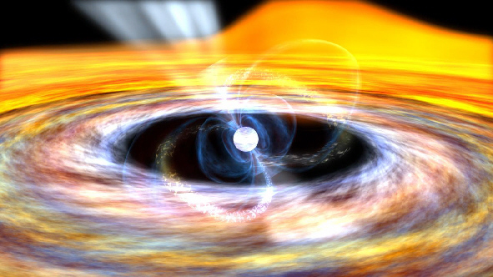
Lecture 5-Angular Momentum
Notes:
Pulsar is a celestial object, thought to be a rapidly rotating neutron star, that emits regular pulses of radio waves and other electromagnetic radiation at rates of up to one thousand pulses per second. Talk about synchronization of earth and moon.

Slide 2

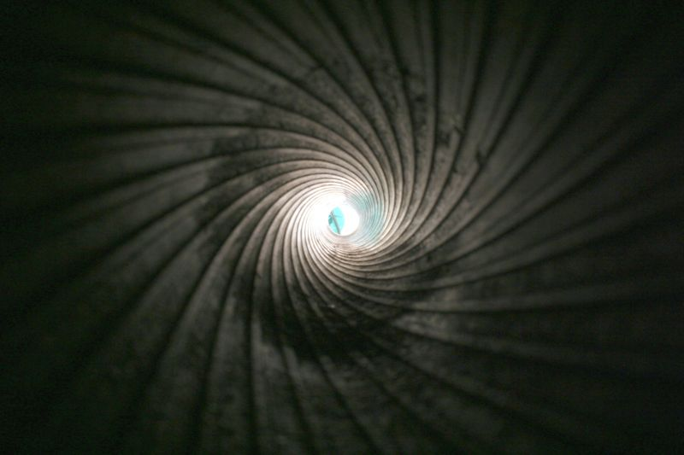
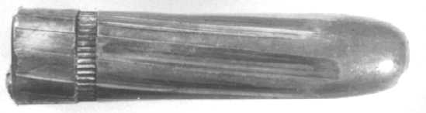
What is the necessity for having grooves in the barrel of the gun?
Notes:
The process of creating grooves in barrel is called rifling. When a body is spinning around some axis, we say the angular momentum is pointing along this axis with a magnitude equal to the magnitude of the angular momentum. When a body has angular momentum is some direction, much like with regular momentum, it doesn't like to have its magnitude or direction changed.
One particular note to this is precession, where the angular momentum of a body spins about a 3rd axis, but it doesn't like to have this 3rd axis changed either.
So, when the bullet has some spin, it has some angular momentum in the direction of its motion. This spinning adds stability, because the bullet itself doesn't want to turn on some other axis, thus changing the direction of its angular momentum, so it stays pointing straight. Since it stays pointing straight, it is more aerodynamic, so it flies for longe

Slide 3
Angular Momentum of a Point Particle
Linear Momentum
m
v
Momentum p = mv
Angular Momentum
θ
The magnitude of angular momentum is given by
Notes:
Explain the concept of linear momentum. From there explain on board the concept of angular momentum by taking origin at different points. Student should be taught that if r and p are in line, the angular momentum is zero.

Slide 4
Angular Momentum of Rigid Bodies and Fixed axis rotation
y
r₁
r₁
x
r₃
r₂
r₃
r₂
Rigid body : Every particle in the body remains at a fixed distance from the axis

Slide 5
Change in magnitude of Angular Momentum and Torque
y
Angular Momentum L = mlv
r
l
v
x
L
Notes:
Do all the calculations on the board. We know that due to the frictional force, velocity decreases. Eventually angular momentum decreases in magnitude. One good way of explaining this is to show the direction of torque which is directed opposite to L and by simple vector substraction, L can be shown to decrease in magnitude.

Slide 6
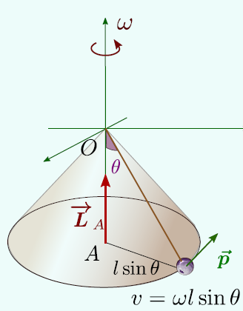
Angular Momentum – Conical Pendulum
Angular Momentum about the point A
Notes:
Please remember to tell the student that between l sine theta and mv it is a multiplication sign

Slide 7
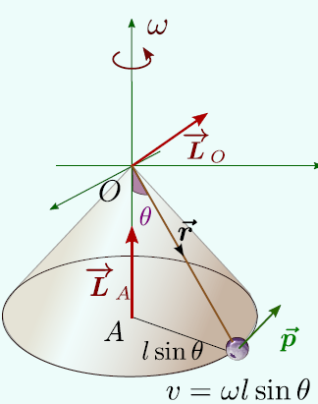
Angular Momentum – Conical Pendulum
Angular Momentum about the point O
Notes:
Work out these calculations manually on the board. Emphasize on the point that magnitude of L depends upon the origin we choose.

Slide 8
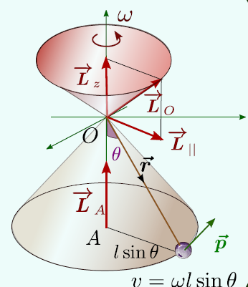
Angular Momentum – Conical Pendulum
Angular Momentum about point A
Angular Momentum about point O

Slide 9
Change in direction of Angular Momentum and Torque
dθ
L(t+dt))
Ldθ
L(t)
ω_{p} is called the precession frequency or the frequency with which the angular momentum vector rotates

Slide 10
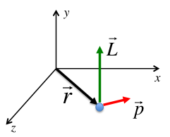
Important Concept to Remember
The direction of angular momentum lies perpendicular to the plane containing and
Depending upon the orientation of and
the direction of angular momentum can point in a particular direction or change its direction with time.
The magnitude of angular momentum depends on the origin we choose

Slide 11
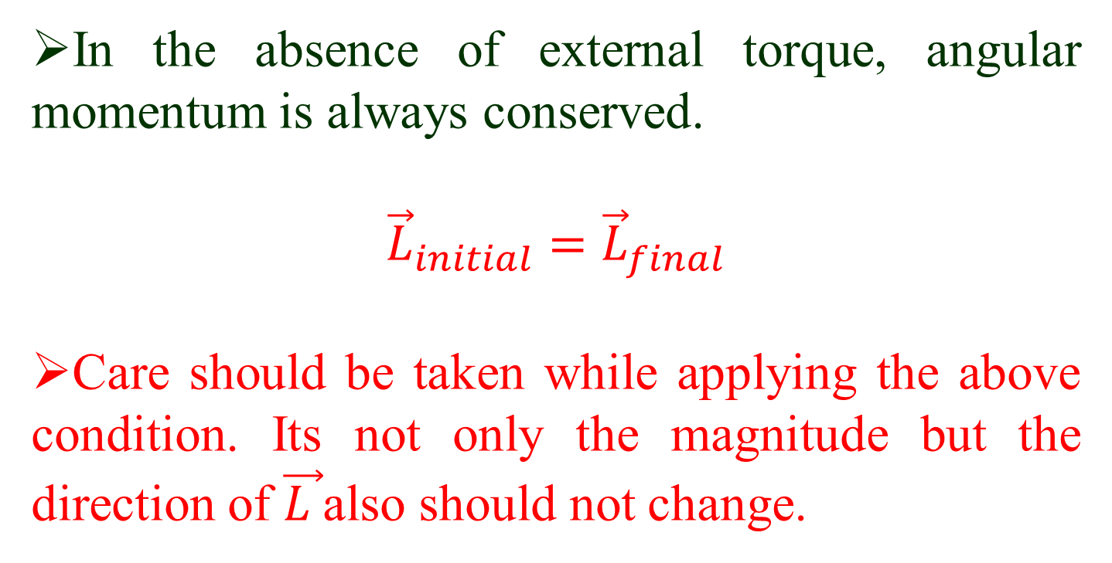
Conservation of Angular Momentum
In the absence of external torque, angular momentum is always conserved.
$${\vec{L}}_{initial}={\vec{L}}_{final}$$
Care should be taken while applying the above condition. Its not only the magnitude but the direction of $\vec{L }$also should not change.
Notes:
Demo using rotating chair.

Slide 12
Summary
Magnitude of angular momentum depends on the choice of origin
Direction of angular momentum always changes along the direction of torque.
When the vector direction of angular momentum rotates about an axis, the frequency with which the angular momentum vector rotates is called the precession frequency ω_{p}

Slide 13
Angular Momentum of Rigid Bodies and Fixed axis rotation
y
r₁
r₁
x
r₃
r₂
r₃
r₂
Two important terms to remember
1. Rigid body : Every particle in the body remains at a fixed distance from the axis
2. Fixed axis rotation : The direction of axis of rotation is always along the same line.
Notes:
So far we have seen rotation of a point particle. Now we will be dealing with rigid bodies rotating about a fixed axis.

Slide 14
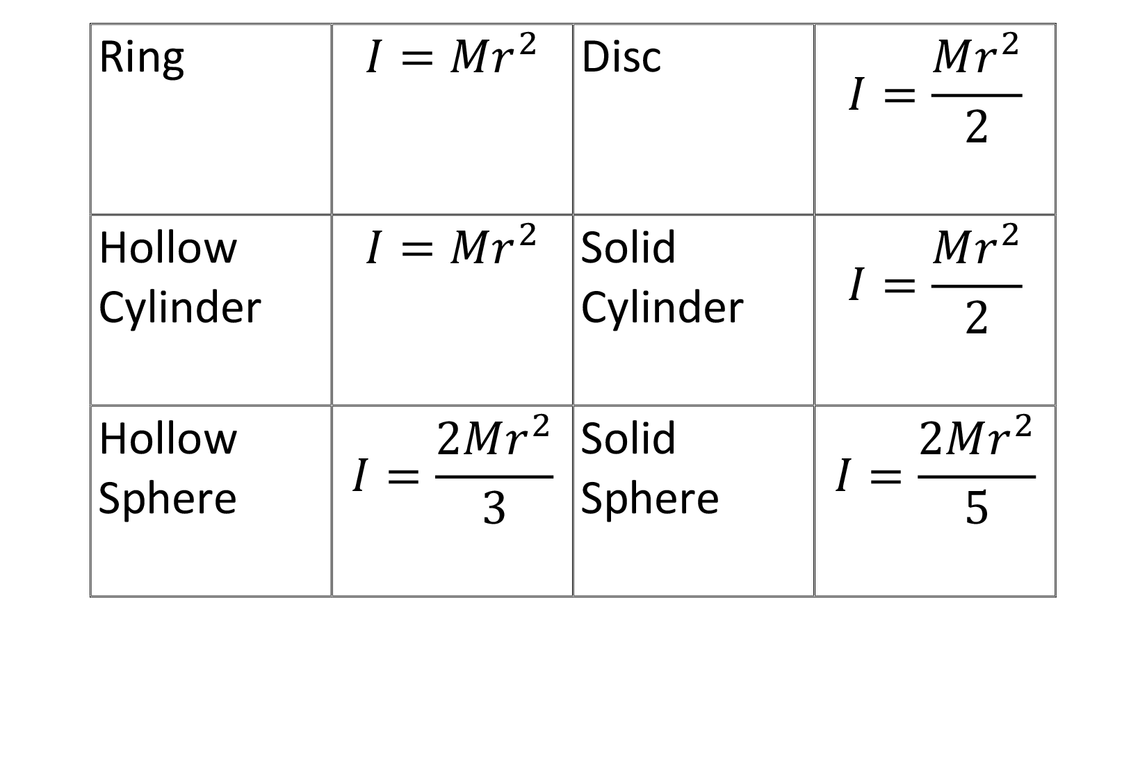
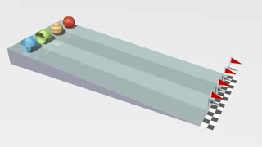
Rolling Racers
4
2
3
1
Notes:
The asssumption is that the mass of all the four objects are same. If not, then the experiment fails

Slide 15
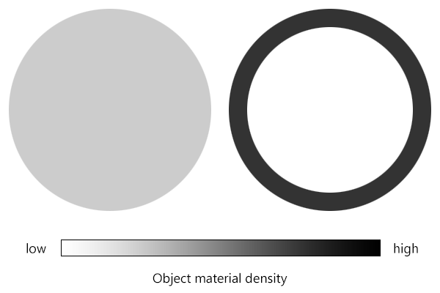
Moment of Inertia
I = 1/2MR²
I = MR²
We need to remember that the above two objects have same mass.

